Slide 1

Fire Department
Team Gosho and friends

Slide 2
Our team
Scrum trainer- Georgi Milev
Frontend Developer- Dimitar Berdankov
Backend Developer- Danislav Todorov
HTML Desginer- Rossen Papazov

Slide 3

Our idea
A site that summarizes some topics of fire safety

Slide 4






Used programs

Slide 5
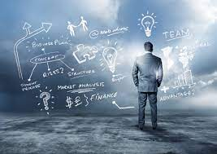
Future ideas
To improve our project
To add new tabs in our site

Slide 6

Our problem
Organization problems

Slide 7
THANKS FOR YOUR ATTENTION

